Slide 1
Part A: Universal Approximators; Nodes and Layers

Slide 2
Design Choices
Activation function
Loss function
Output units
Architecture
Optimizer

Slide 3
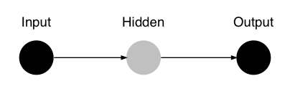
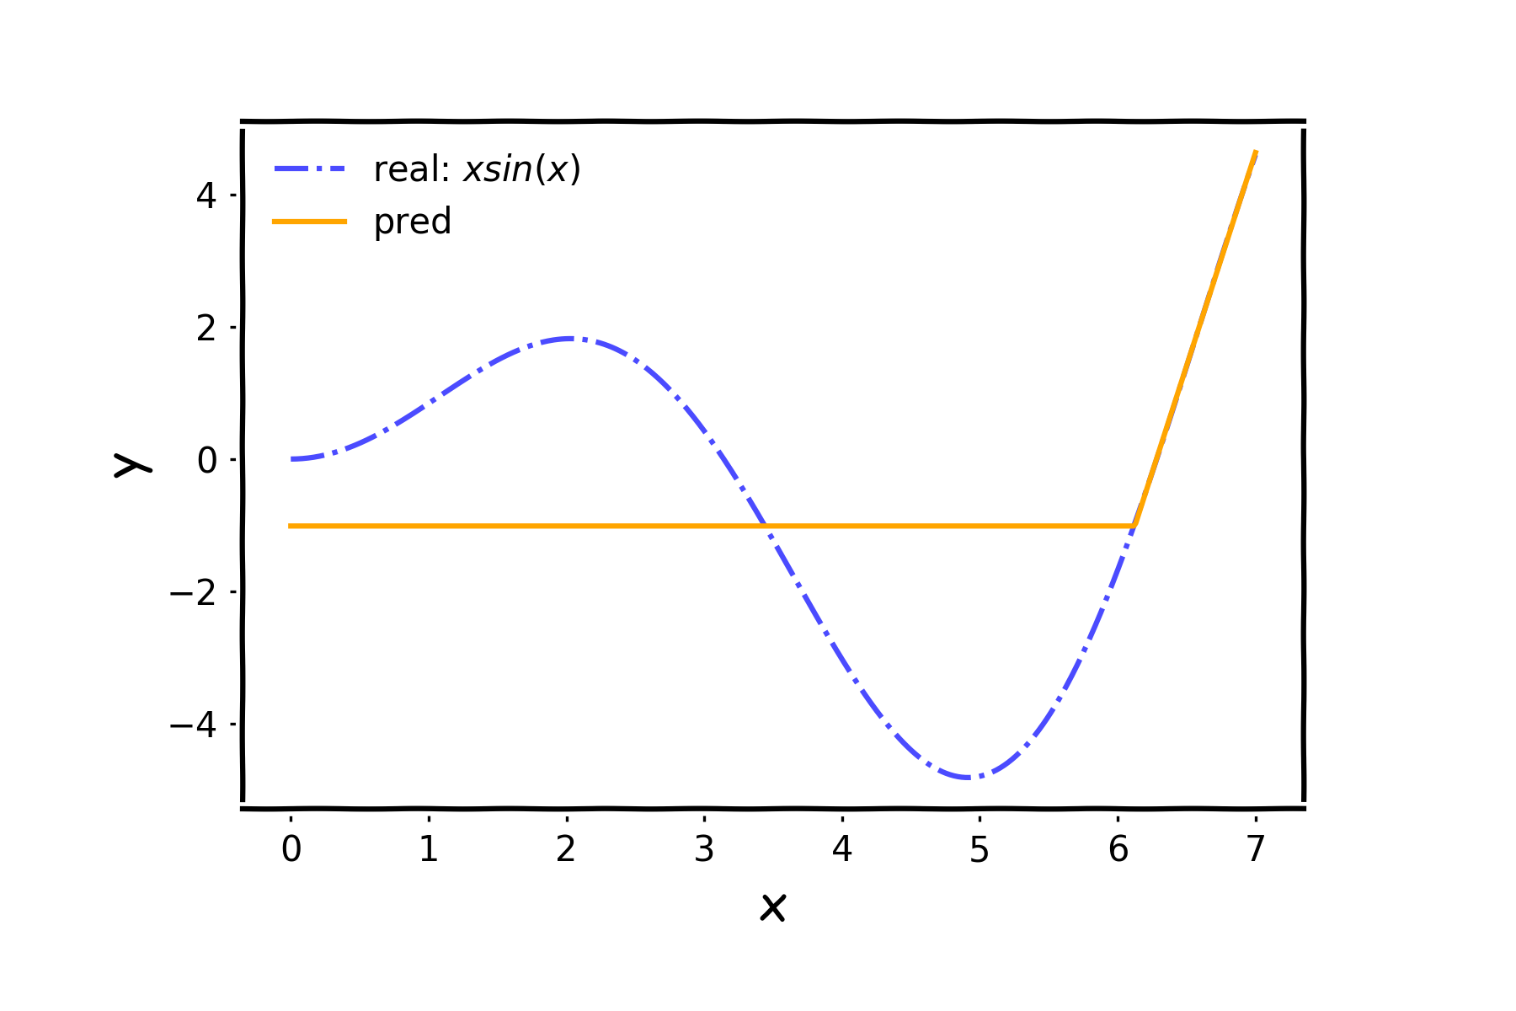
Number of nodes

Slide 4
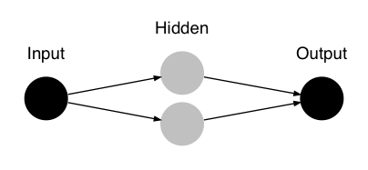
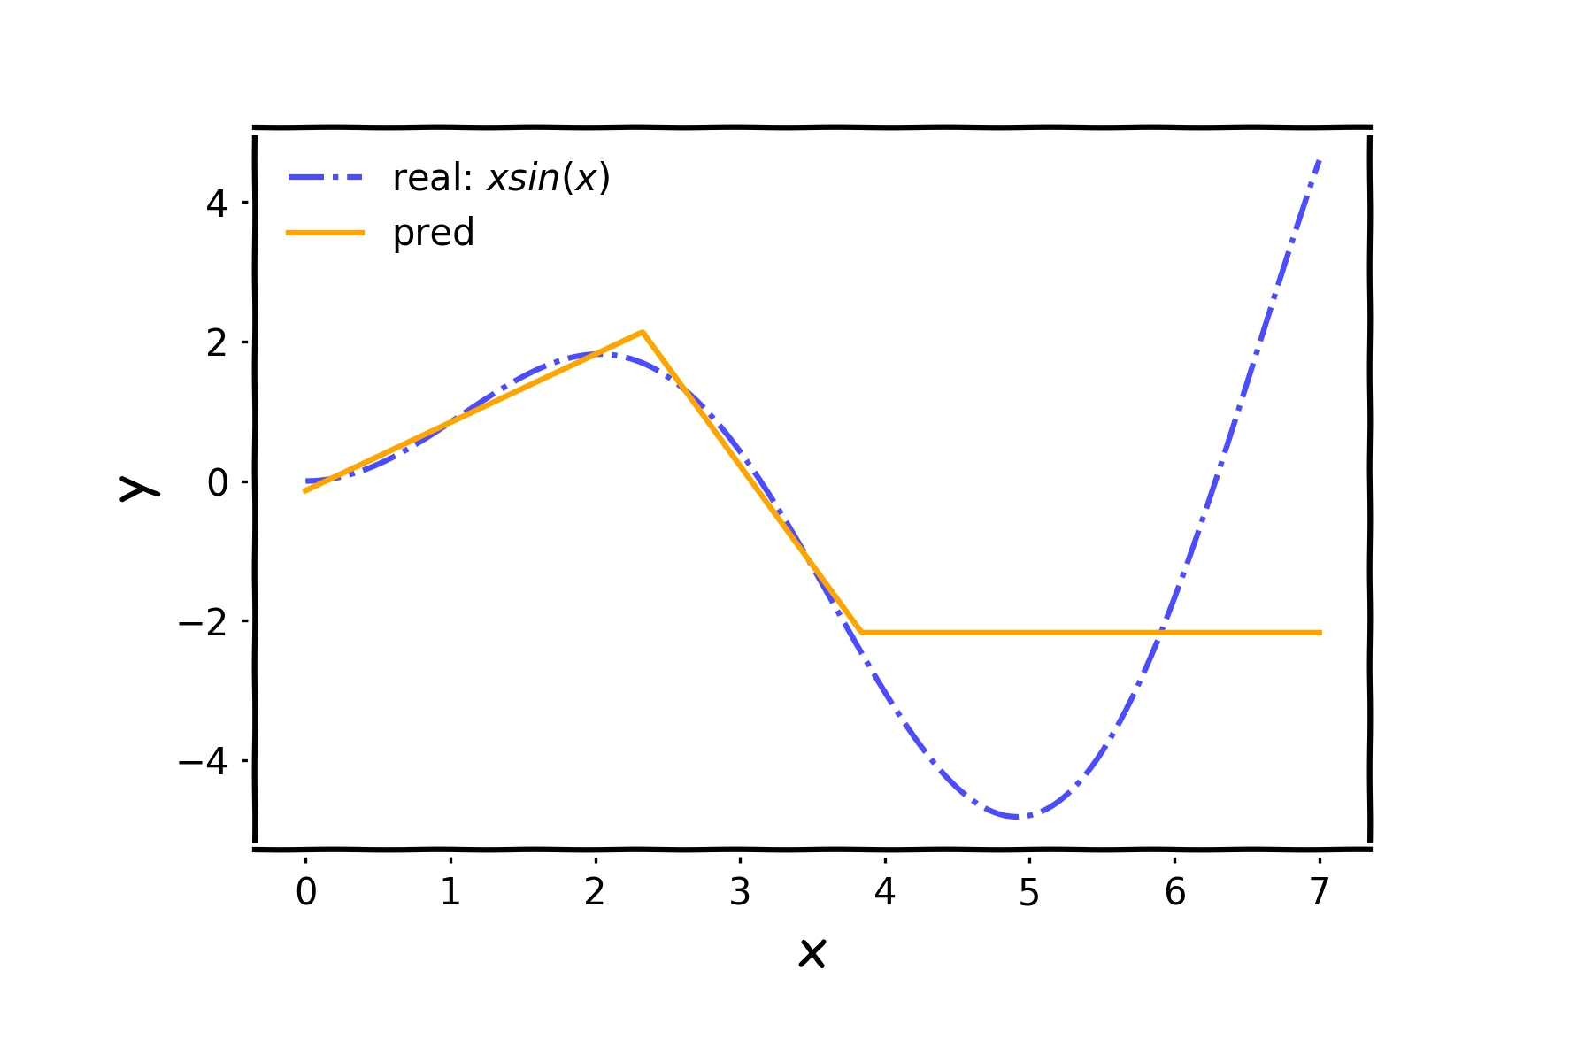
Number of nodes

Slide 5
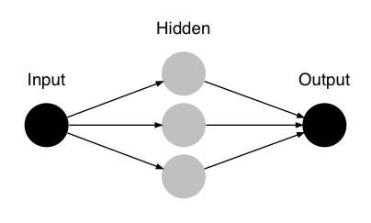
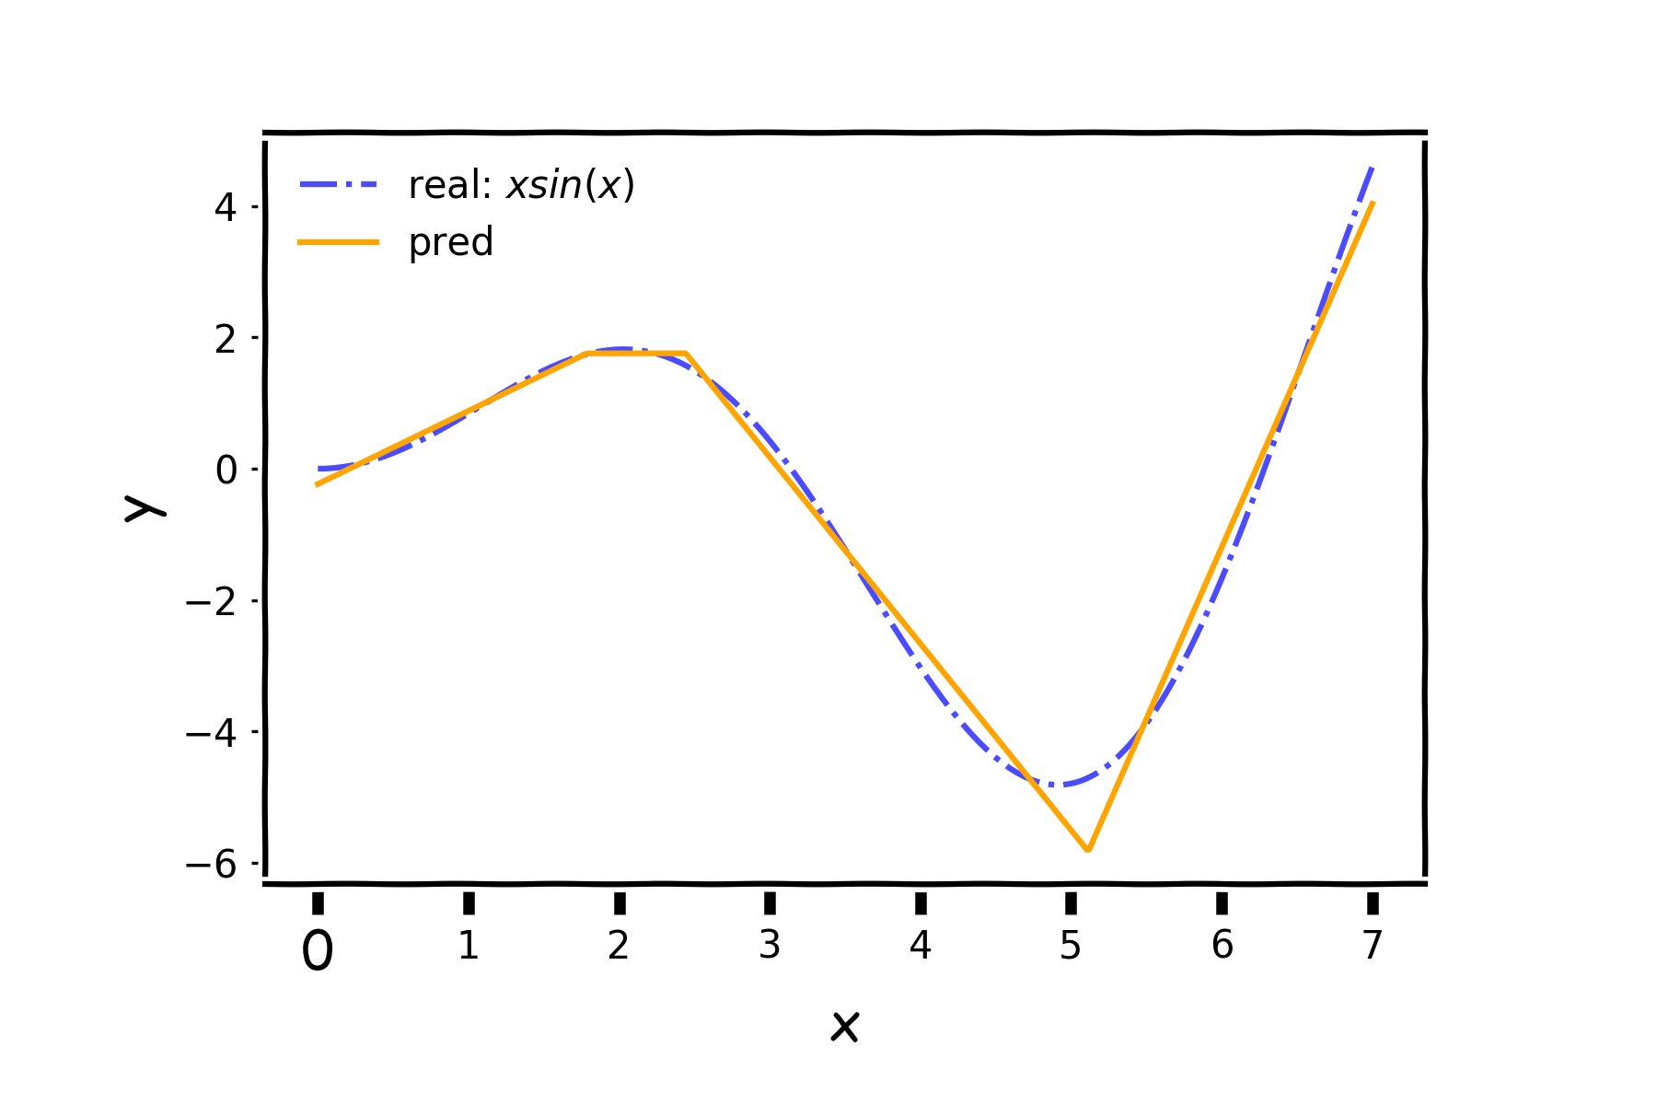
Number of nodes

Slide 6
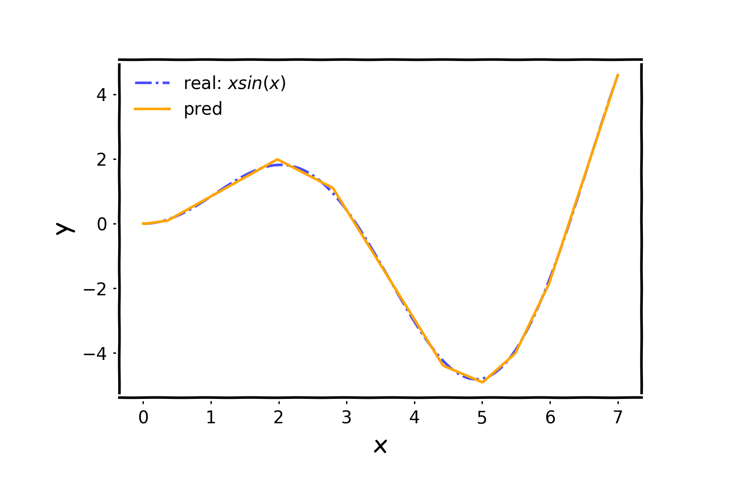
Number of nodes
…

Slide 7
Neural Networks as Universal Approximators
We have seen that neural networks can represent complex functions, but are there limitations on what a neural network can express?
Theorem:
For any continuous function f defined on a bounded domain, we can find a neural network that approximates f with an arbitrary degree of accuracy.
One hidden layer is enough to represent an approximation of any function to an arbitrary degree of accuracy.
So why deeper?

Slide 8
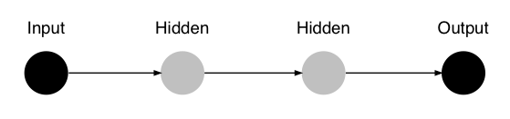
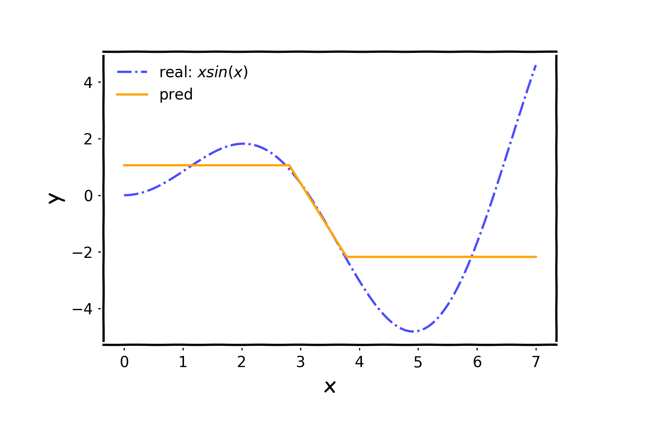
Layers

Slide 9
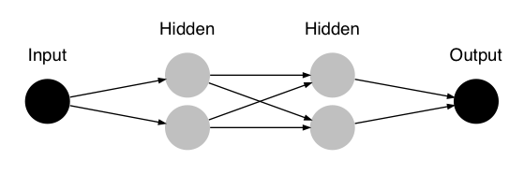
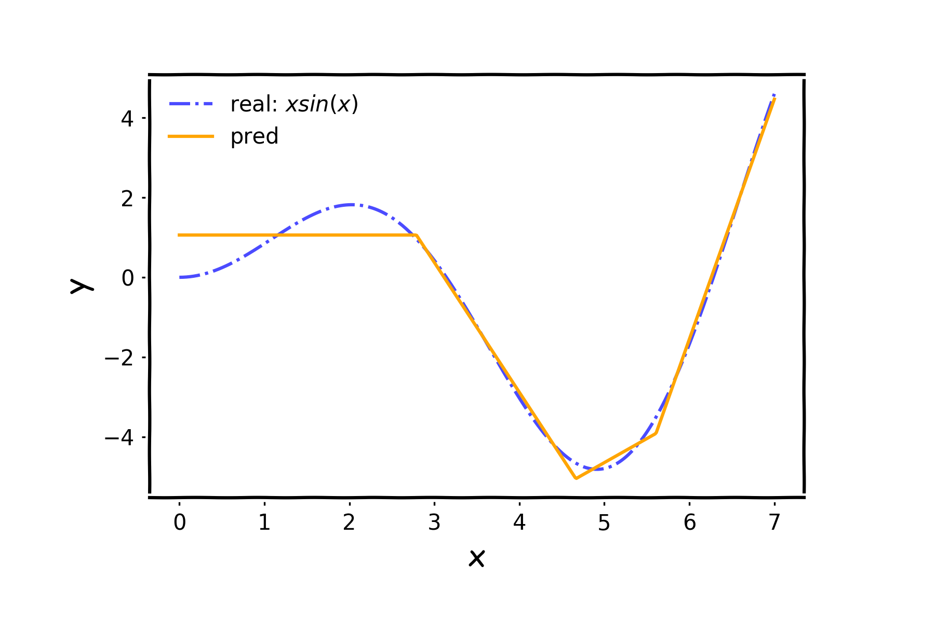
Layers

Slide 10
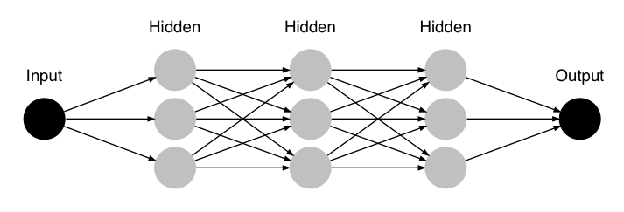
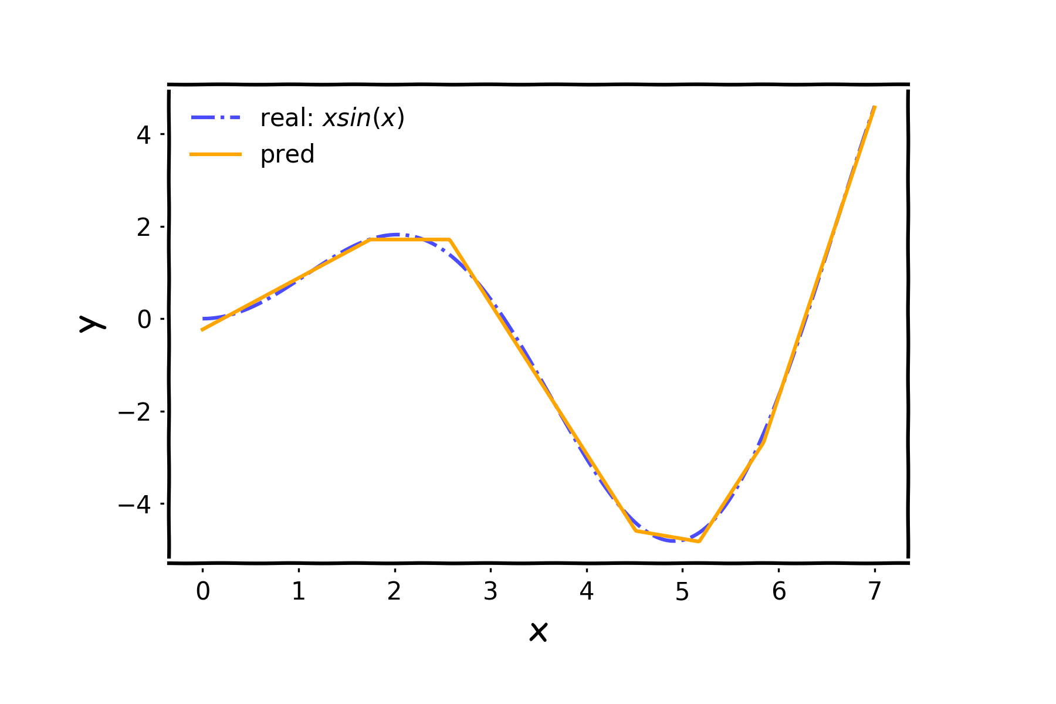
Layers

Slide 11
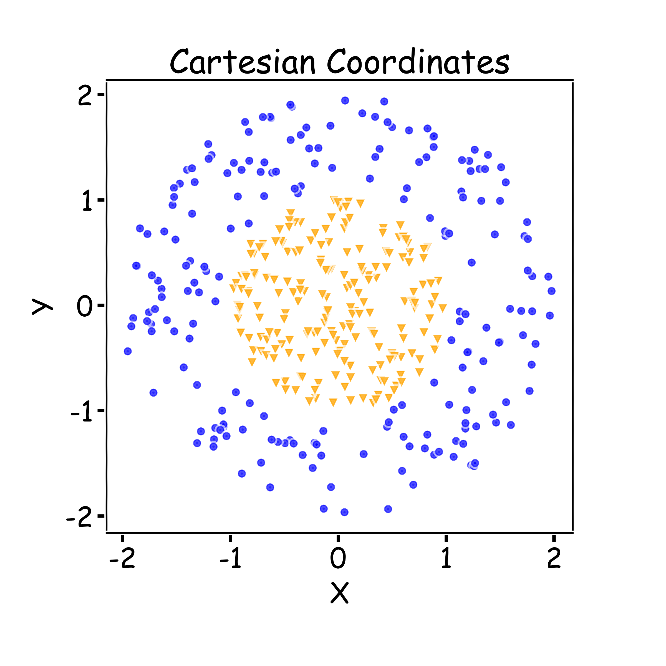
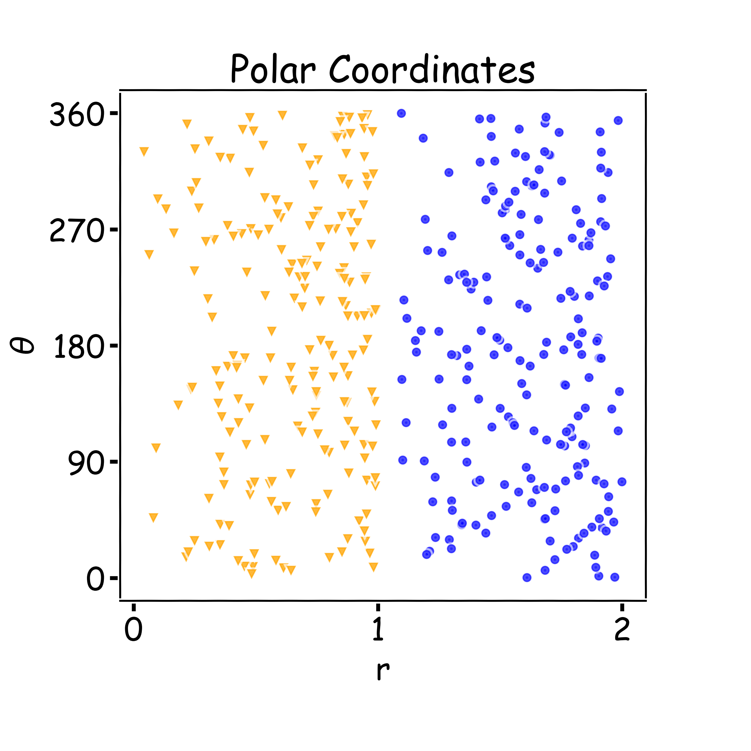
Why layers?
Representation matters!
Neural networks can learn useful representations for the problem. This is another reason why they can be so powerful!

Slide 12
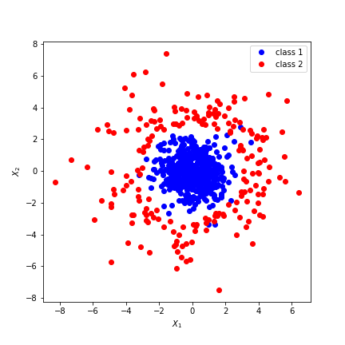
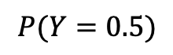
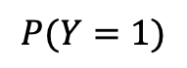


input
hidden₁
hidden₂
output
$$h_{1}$$
$$P(Y=1)$$
$$h_{2}$$
$$P(Y=0.5)$$

Slide 13
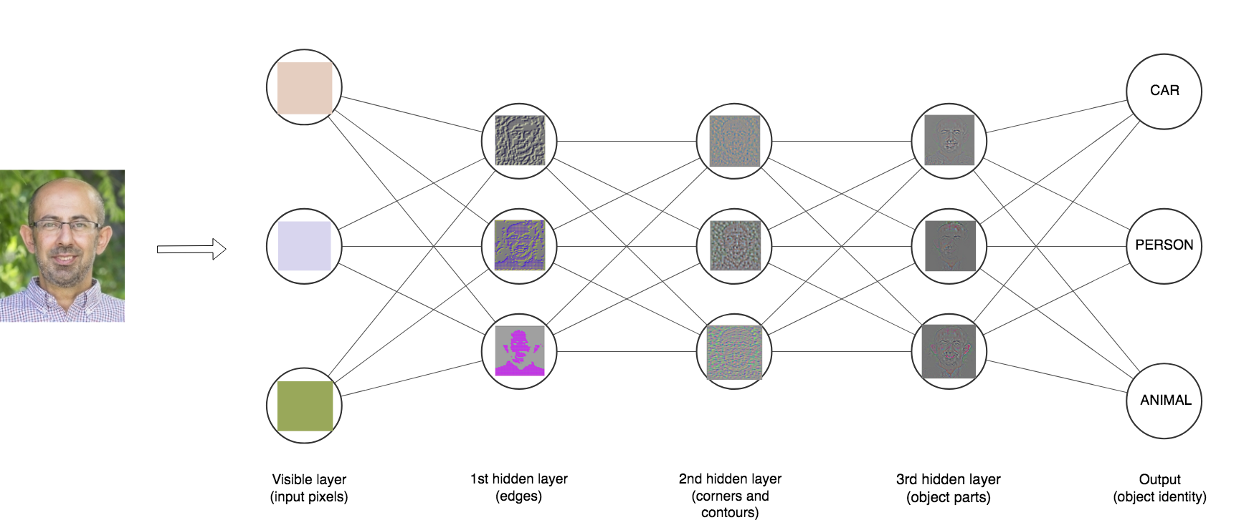

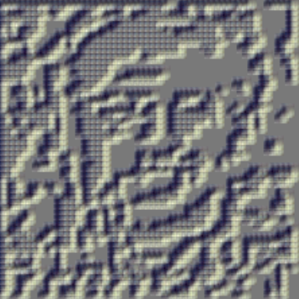
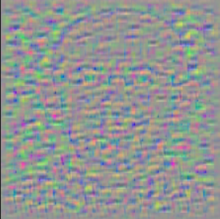
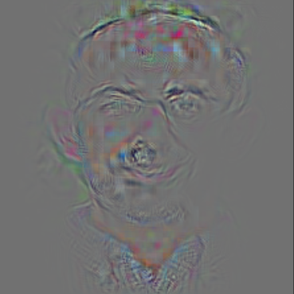

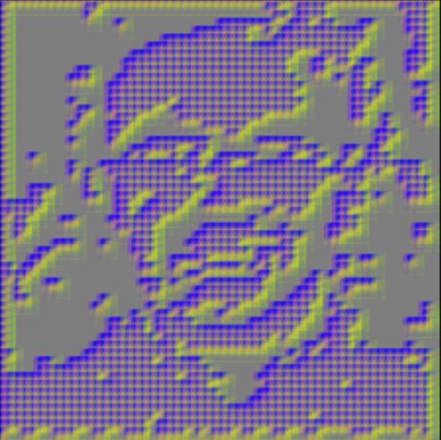
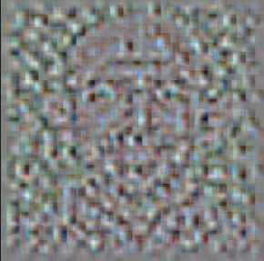
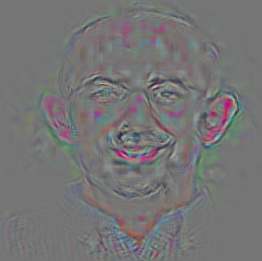
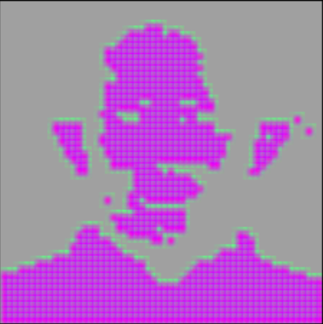
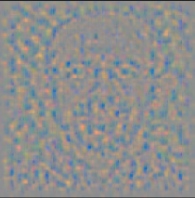
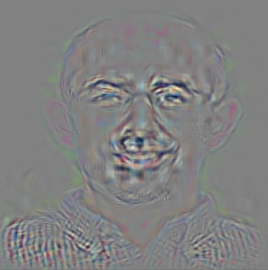

Depth = Repeated Compositions

Slide 14
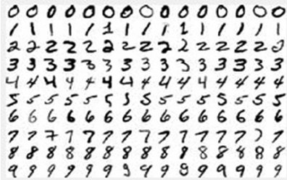
Neural Networks
Hand-written digit recognition: MNIST data

Slide 15
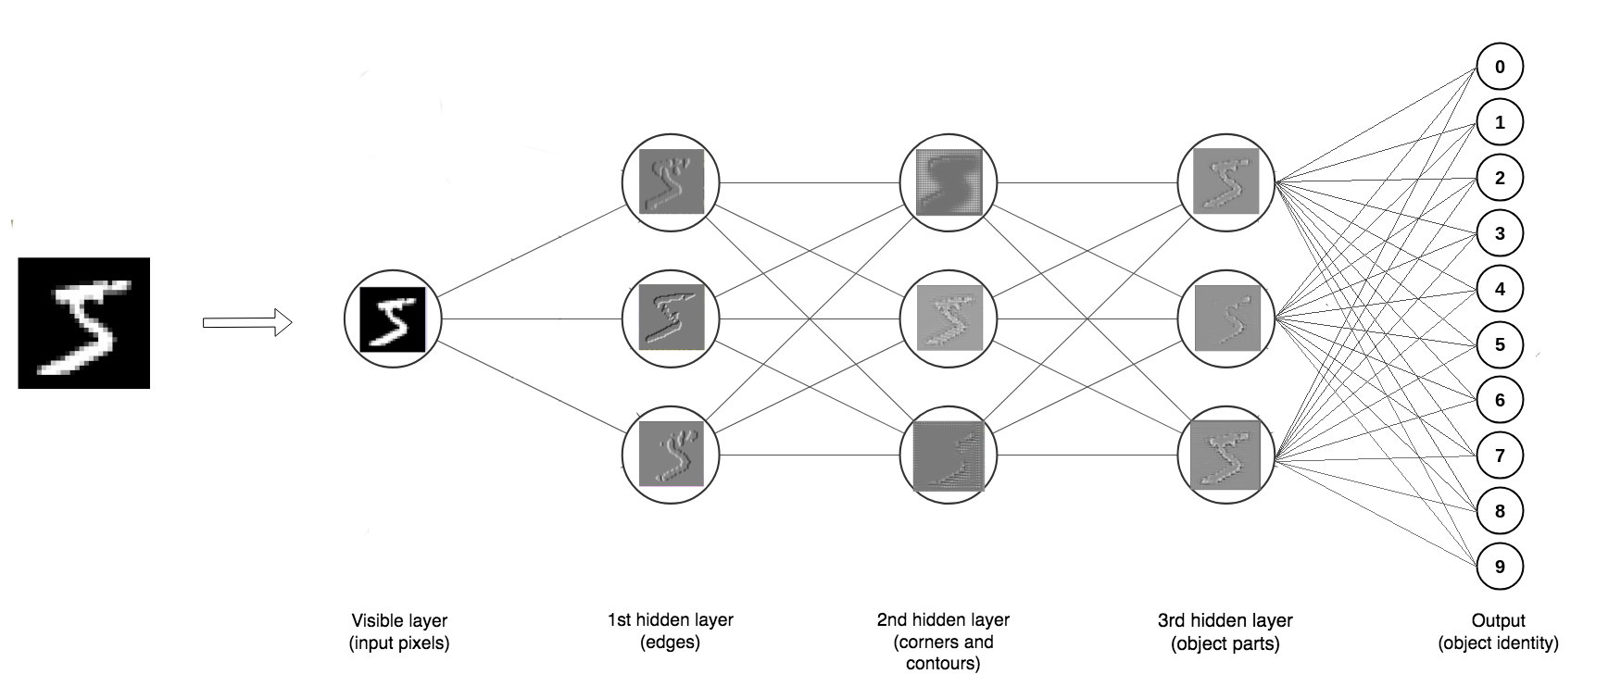
Depth = Repeated Compositions

Slide 16
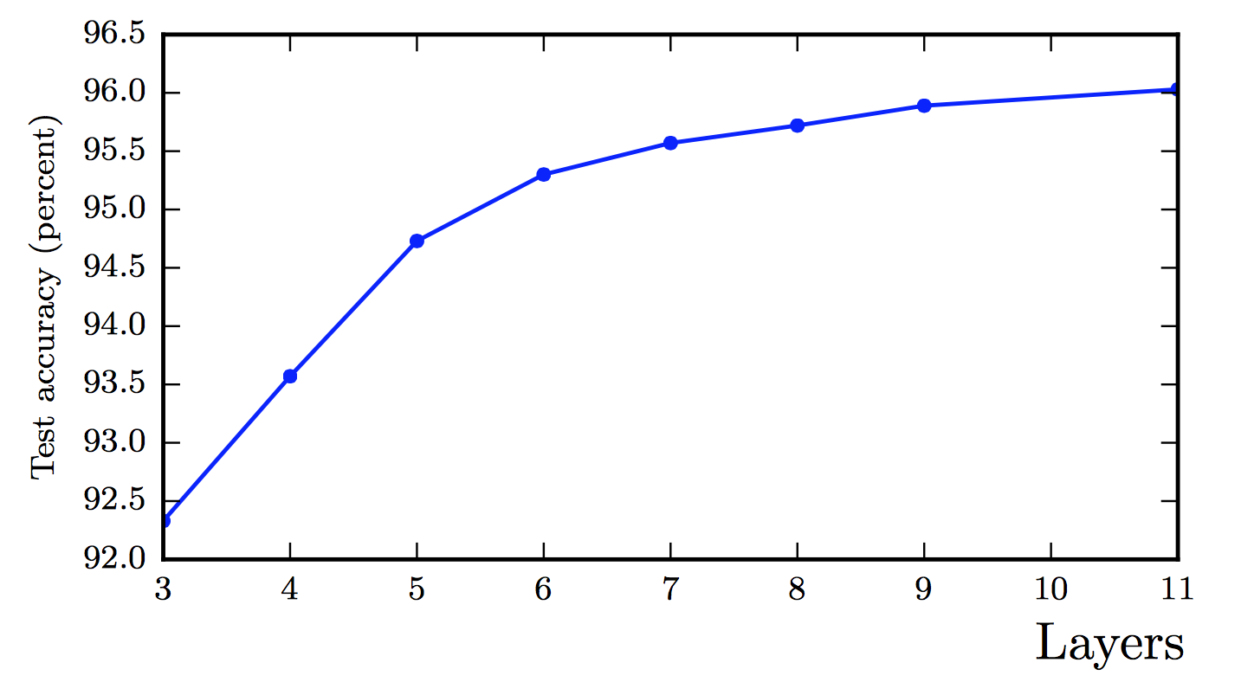
Better Generalization with Depth
(Goodfellow 2017)

Slide 17
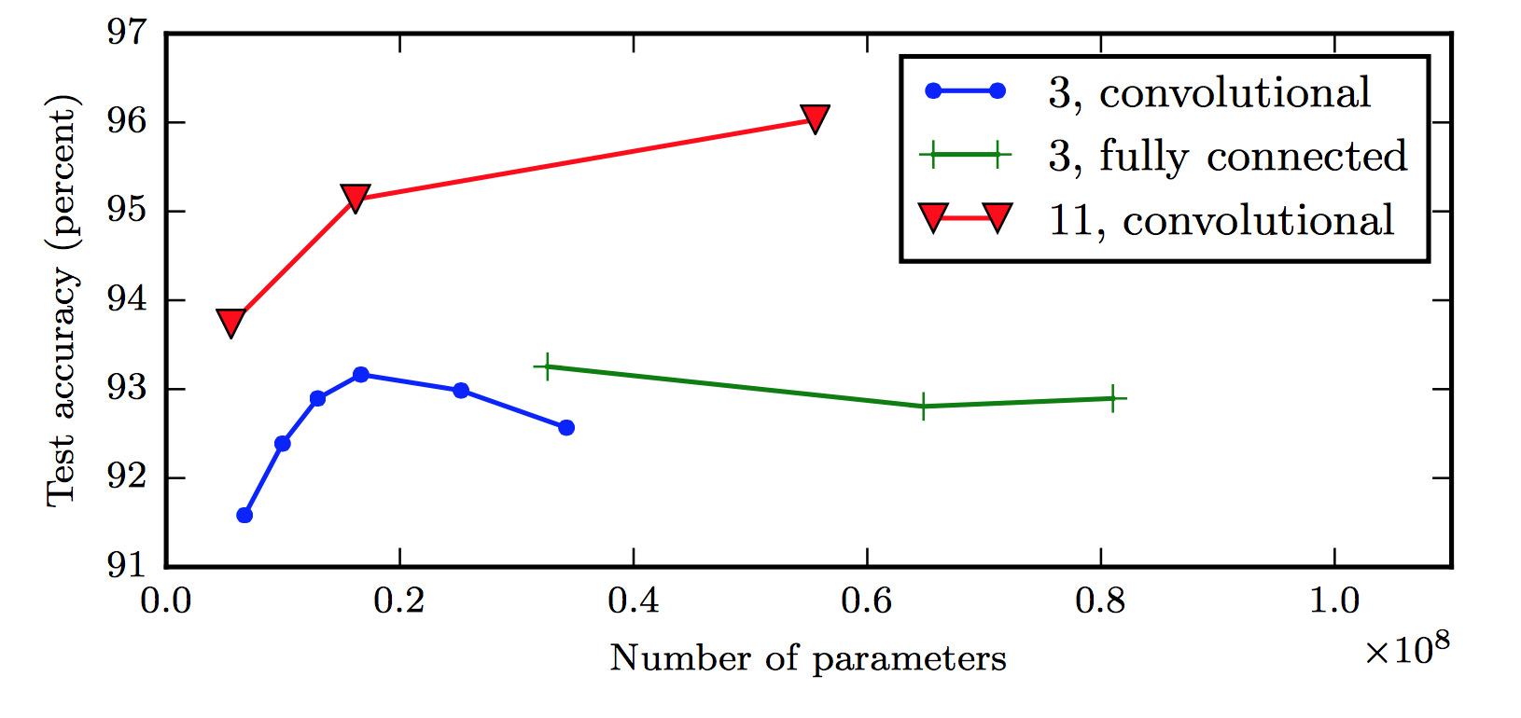
Shallow Nets Overfit More
Depth helps, and it’s not just because of more parameters
Don’t worry about this word “convolutional”. It’s just a special type of neural network, often used for images.
(Goodfellow 2017)
The 11-layer net generalizes better on the test set when controlling for number of parameters.
The 3-layer nets perform worse on the test set, even with similar number of total parameters.

Slide 18
Classifier using Keras on Iris data

